Slide 1
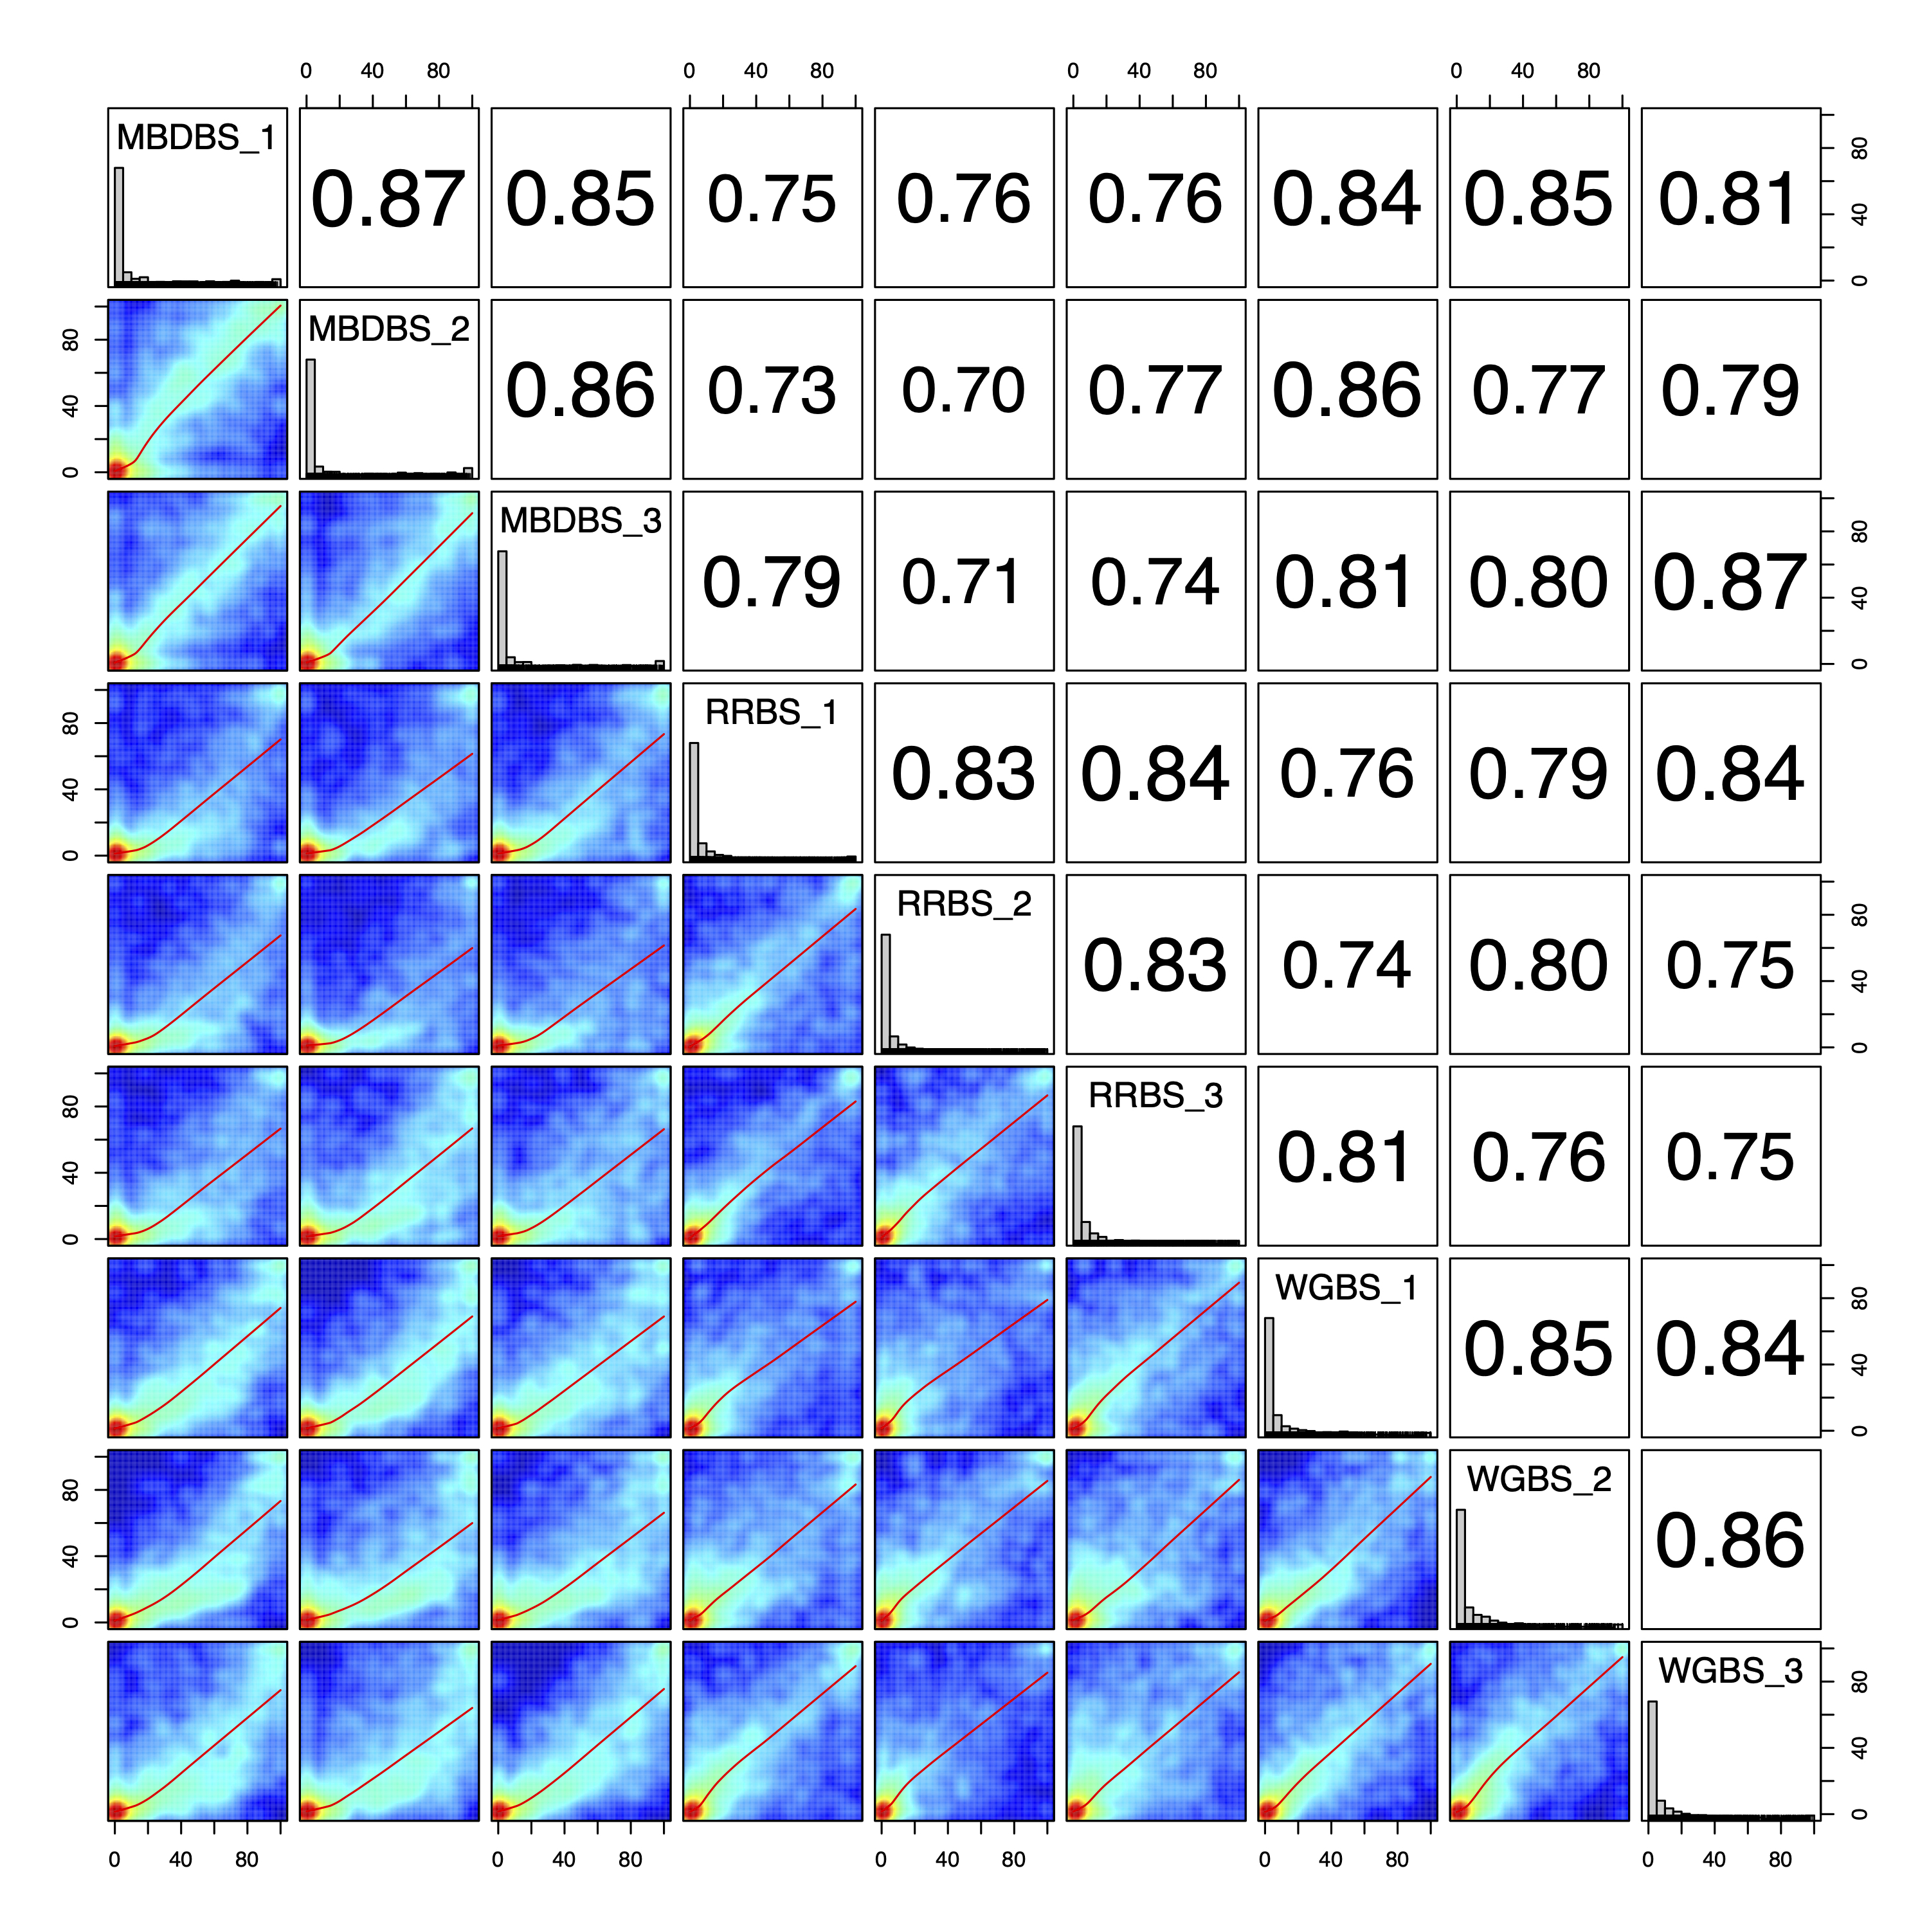
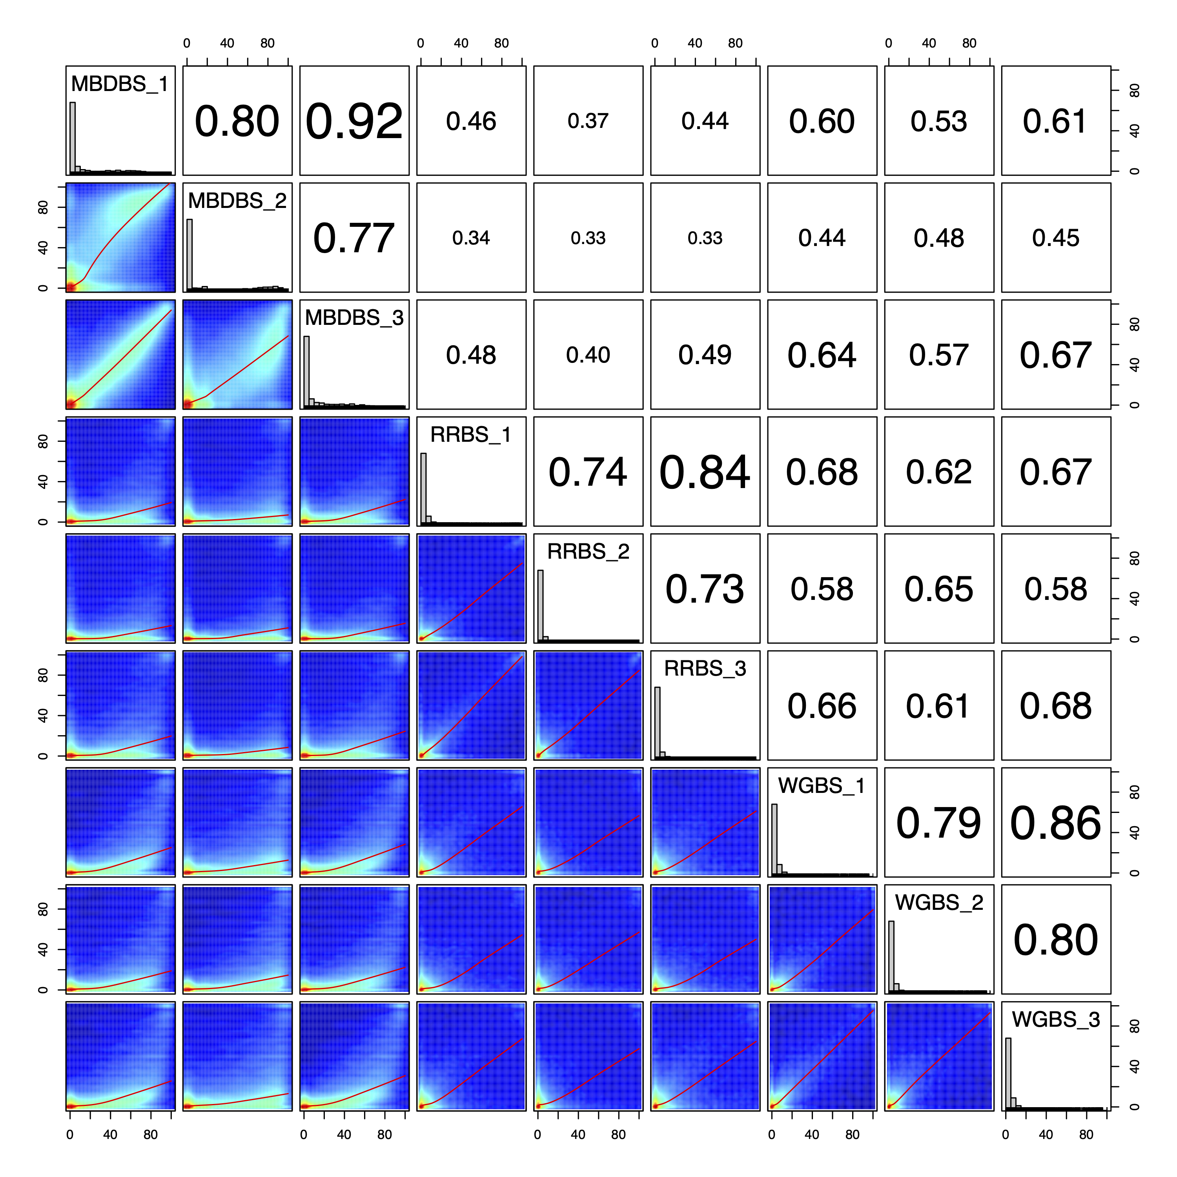
A
M. capitata
% methylation
% methylation
B
P. acuta
% methylation
% methylation

